Slide 1
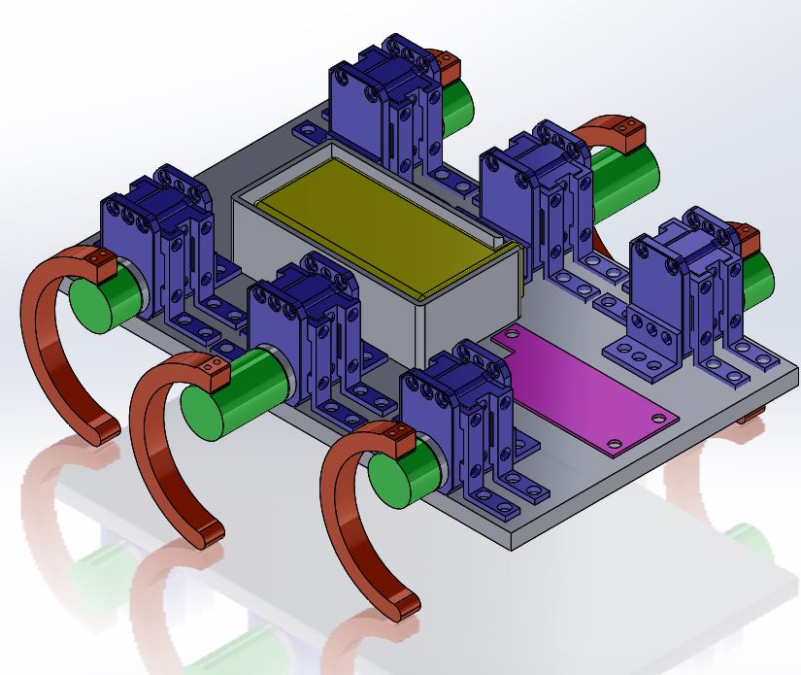
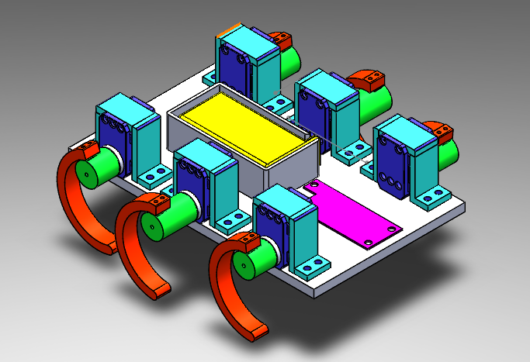
RHex Mini Design Review
Scott Phillips

Slide 2
Goals of RHex Mini
Function in a controlled, simple environment
Work identical to XRL
Be able to walk forward, backward, and turn
Be as resistant as possible to unknown forces and accidents, since being used for robotics education
Cost less than $200 to build

Slide 3
Design Constraints
Servos have 60 degree deadband
In order to accommodate, servos are placed with deadband facing upward
This design increases height, but greatly reduces length
Must be smaller in scale, but have same length to width to height ratio
Materials used should be preferably prepared by laser cutter or 3-D printer
Battery is bulkiest part, and is the primary space constraint
Battery must be 7.4 V to provide the correct amount of power to Dynamixel servos and OPEN-CM mainboard

Slide 4
Connections
Servos to leg shafts – 3-D printed, 18-mm diameter shafts. Connect to servo horn by a screw which sandwiches the shaft. Four “keys” on the shaft end transmit the torque
Leg shafts to legs – two screws bolt the leg in place, held by nuts on the other side. Makes for easy replacement
Servos to foundation – one 3-D printed cover which encloses servo and bolts down on either side, with room for wires to come out. Restricts motion in x, y, and z
Battery case to foundation – Four bolts on the corners, secured by nuts
Mainboard to foundation – elevated above foundation on four corners

Slide 6
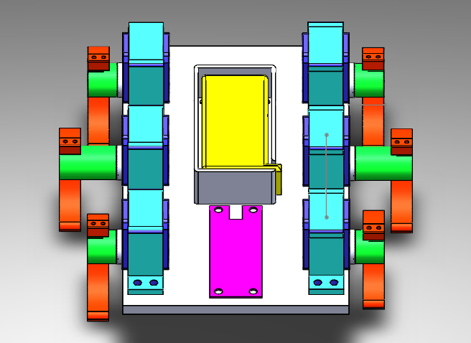

Slide 7
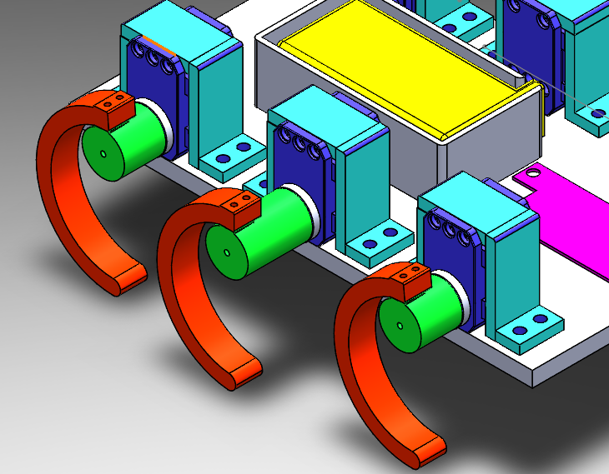

Slide 8
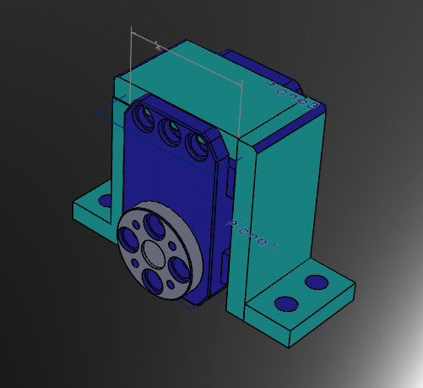

Slide 9
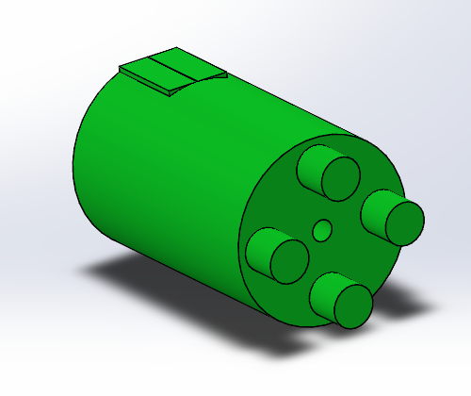

Slide 10
